Slide 1
Review CAR 123911221

Slide 2
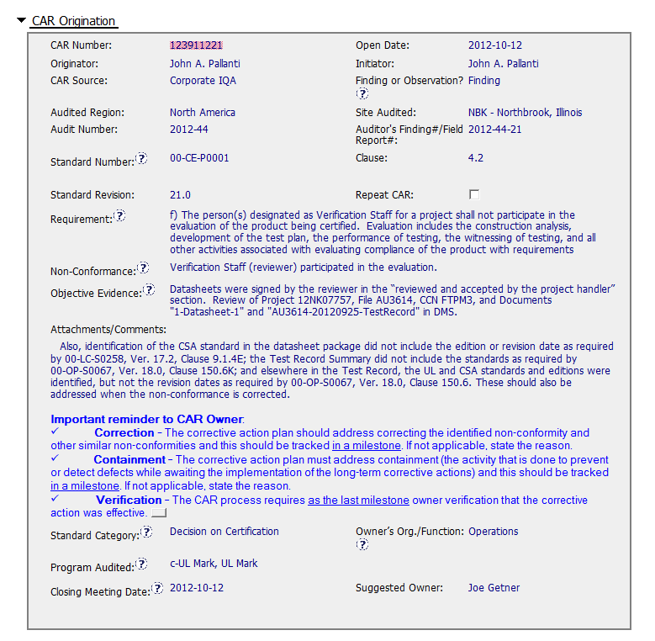
CAR – 123911221
Clear statement of issue (s)
CAR Owner information provided

Slide 3
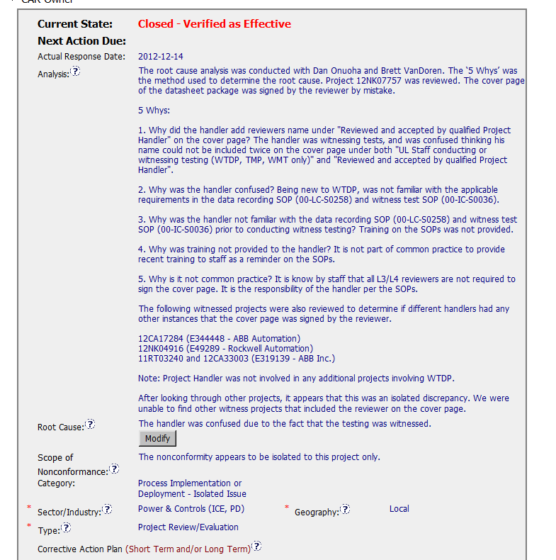
CAR - 123911221
Stakeholders identified
Method identified and used
Further analysis to check scope of issue
Improvement – Why did the Review (non E2E Project) not identify the issues.
Scope in terms of Reviewer’s projects
Improvement ? Correct Root Cause ?
Data recording requirements not all specific to witness testing
Check other projects by Project Handler and Reviewer
Notes: Improvements may lead to updated Corrective Action Plan.

Slide 4
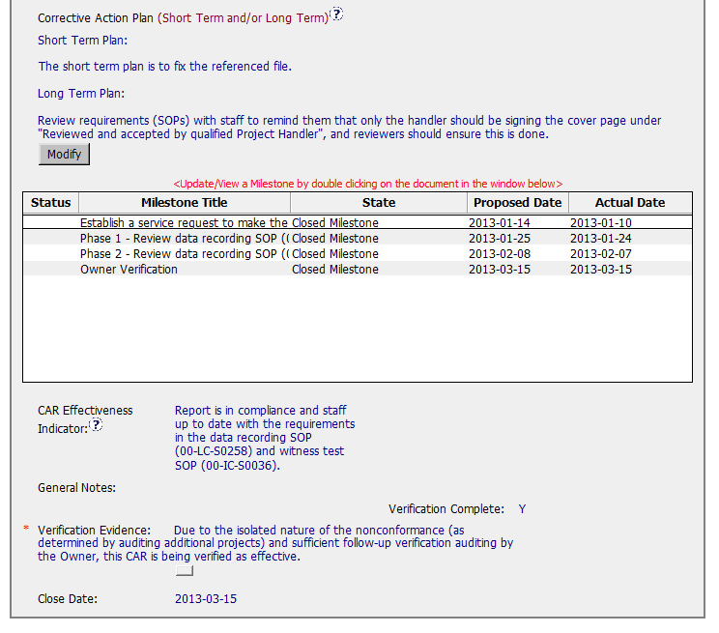
CAR - 123911221
Structured
Corrective Action Plan
as required
Relevant procedures identified
Verification rationale stated

Slide 5
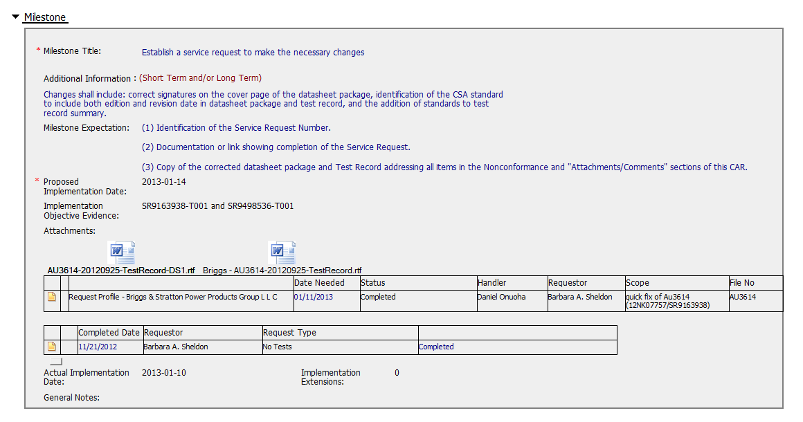
CAR - 123911221
Both issues addressed
Attachments
SR numbers
and links provided

Slide 6
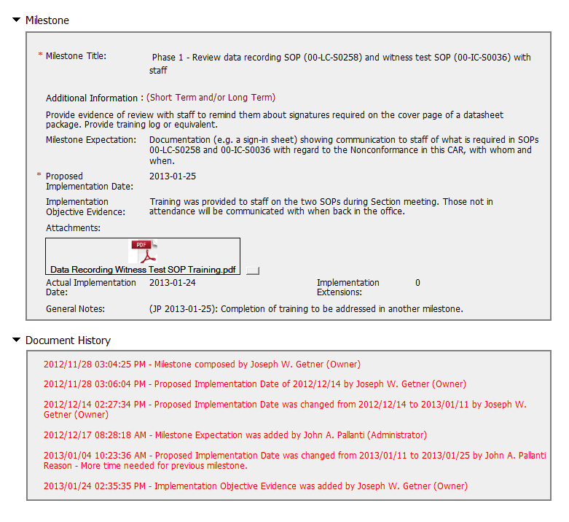
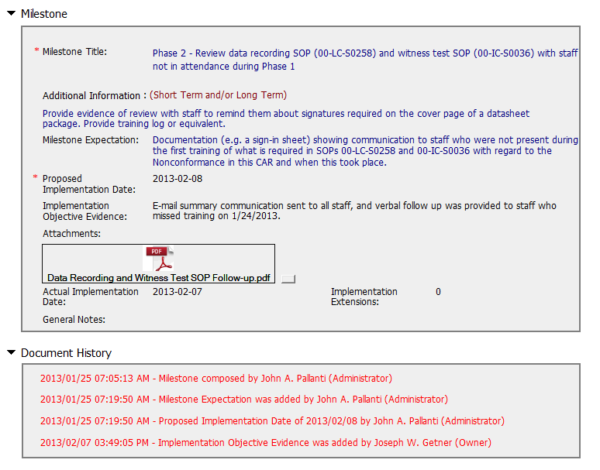
CAR - 123911221
Procedures identified
Recorded evidence:
Improvement: State Project Handler
and Reviewer are covered
Additional milestone added to
Address outstanding action
Improvement: Could confirmation
have been provided
for email/verbal follow up?

Slide 7
CAR REVIEW
FINDING
123911221
Mark Jessen

Slide 8
Noncompliance Statement
Standard: 00-CE0001, Clause 4.2
Requirement: f) The person(s) designated as Verification Staff for a project shall not participate in the evaluation of the product being certified. Evaluation includes the construction analysis, development of the test plan, the performance of testing, the witnessing of testing, and all other activities associated with evaluating compliance of the product with requirements
Non-Conformance: Verification Staff (reviewer) participated in the evaluation.
Objective Evidence: Datasheets were signed by the reviewer in the “reviewed and accepted by the project handler” section. Review of Project 12NK07757, File AU3614, CCN FTPM3, and Documents "1-Datasheet-1" and "AU3614-20120925-TestRecord" in DMS.
NON-CONFORMANCE CLEARLY WRITTEN AND SUPPORTED IN REQUIRMENT AND OBJECTIVE EVIDENCE

Slide 9
Noncompliance Statement
Included in Attachment / Comments Section of CAR
Also, identification of the CSA standard in the datasheet package did not include the edition or revision date as required by 00-LC-S0258, Ver. 17.2, Clause 9.1.4E; the Test Record Summary did not include the standards as required by 00-OP-S0067, Ver. 18.0, Clause 150.6K; and elsewhere in the Test Record, the UL and CSA standards and editions were identified, but not the revision dates as required by 00-OP-S0067, Ver. 18.0, Clause 150.6. These should also be addressed when the non-conformance is corrected.
Question for group – While the approach of placing technical content in the Comment Section of the CAR is customer friendly and clearly worked in this CAR, would it be better to include all non-compliance issues in the Requirements / Objective Evidence sections of the CAR and include under a single Project Handling procedural / ISO Standard requirement? Or perhaps open SRs to accomplish the work and not record as additional information for this CAR? ALSO - Issues were handled as “Observation” but were included in Finding CAR. Assume Finding criteria was not intended to be applied based on content of issues

Slide 10
Analysis
The root cause analysis was conducted with Dan Onuoha and Brett VanDoren. The ‘5 Whys’ was the method used to determine the root cause. Project 12NK07757 was reviewed. The cover page of the datasheet package was signed by the reviewer by mistake. 5 Whys: 1. Why did the handler add reviewers name under "Reviewed and accepted by qualified Project Handler" on the cover page? The handler was witnessing tests, and was confused thinking his name could not be included twice on the cover page under both "UL Staff conducting or witnessing testing (WTDP, TMP, WMT only)" and "Reviewed and accepted by qualified Project Handler". 2. Why was the handler confused? Being new to WTDP, was not familiar with the applicable requirements in the data recording SOP (00-LC-S0258) and witness test SOP (00-IC-S0036). 3. Why was the handler not familiar with the data recording SOP (00-LC-S0258) and witness test SOP (00-IC-S0036) prior to conducting witness testing? Training on the SOPs was not provided. 4. Why was training not provided to the handler? It is not part of common practice to provide recent training to staff as a reminder on the SOPs. 5. Why is it not common practice? It is know by staff that all L3/L4 reviewers are not required to sign the cover page. It is the responsibility of the handler per the SOPs. The following witnessed projects were also reviewed to determine if different handlers had any other instances that the cover page was signed by the reviewer. 12CA17284 (E344448 - ABB Automation) 12NK04916 (E49289 - Rockwell Automation) 11RT03240 and 12CA33003 (E319139 - ABB Inc.) Note: Project Handler was not involved in any additional projects involving WTDP. After looking through other projects, it appears that this was an isolated discrepancy. We were unable to find other witness projects that included the reviewer on the cover page.
STAKEHOLDERS IDENTIFED – “5 WHY” PROBLEM SOLVING METHODOLOGY USED EFFECTIVLY – OVER USED CATEGORY OF “TRAINING’ CORECTLY JUSTIFED IN THIS CAR – “ONE OFF” JUSTIFED THROUGH REVIEW OF THREE PROJECTS – IMPACT ANALYSIS CONDUCTED AS PROJECT HANDLER HAD NOT PARTICIPATED IN ADDITIONAL WTDP PROJECTS

Slide 11
Root Cause
Root Cause: The handler was confused due to the fact that the testing was witnessed.
Scope of Nonconformance: The nonconformity appears to be isolated to this project only.
Category: Process Implementation or Deployment - Isolated Issue
Sector/Industry: Power & Controls (ICE, PD)
Geography Local
Type: Project Review/Evaluation
ROOT CAUSE AND SCOPE OF NONCONFORMITY SUPPORTED IN ANALYSIS – CATEGORY, SECTOR ,GEOGRAPHY AND TYPE CORRECT

Slide 12
Corrective Action Plan
Milestone Title: Establish a service request to make the necessary changes
CAR Administrator Guidance - Changes shall include: correct signatures on the cover page of the datasheet package, identification of the CSA standard to include both edition and revision date in datasheet package and test record, and the addition of standards to test record summary.
Milestone Expectation:
(1) Identification of the Service Request Number. (2) Documentation or link showing completion of the Service Request. (3) Copy of the corrected datasheet package and Test Record addressing all items in the Nonconformance and "Attachments/Comments" sections of this CAR.
Objective Evidence: SR9163938-T001 and SR9498536-T001
MILESTONE MATCHES ANALYSIS AND ROOT CAUSE STATEMENT - CONTAINMENT ADDRESSED IN OBJECTIVE EVIDENCE RESOLUTION (INCLUDED ISSUES IN COMMENT SECTION) SOP TRAINING AND PRIOR ANALYSIS DISCUSSIONS WITH L2 AND L3 PROJECT HANDLER – SR LINKS PROVIDED AS OBJECTIVE EVIDENCE

Slide 13
Corrective Action Plan
Milestone Title: Phase 1 - Review data recording SOP (00-LC-S0258) and witness test SOP (00-IC-S0036) with staff
CAR Administrator Guidance - Provide evidence of review with staff to remind them about signatures required on the cover page of a datasheet package. Provide training log or equivalent.
Milestone Expectation: Documentation (e.g. a sign-in sheet) showing communication to staff of what is required in SOPs 00-LC-S0258 and 00-IC-S0036 with regard to the Nonconformance in this CAR, with whom and when.
Implementation Objective Evidence: Training was provided to staff on the two SOPs during Section meeting. Those not in attendance will be communicated with when back in the office.
MILESTONE MATCHES ANALYSIS AND ROOT CAUSE STATEMENT – TRAINING LOG ATTACHED AS OBJECTIVE EVIDENCE

Slide 14
Corrective Action Plan
Milestone Title: Phase 2 - Review data recording SOP (00-LC-S0258) and witness test SOP (00-IC-S0036) with staff not in attendance during Phase 1
CAR Administrator Guidance - Provide evidence of review with staff to remind them about signatures required on the cover page of a datasheet package. Provide training log or equivalent.
Milestone Expectation: Documentation (e.g. a sign-in sheet) showing communication to staff who were not present during the first training of what is required in SOPs 00-LC-S0258 and 00-IC-S0036 with regard to the Nonconformance in this CAR and when this took place.
MILESTONE MATCHES ANALYSIS AND ROOT CAUSE STATEMENT – “EQUIVALENT’ METHOD USED IN LIEU OF TRAINING LOG – OWNER ‘AVIDAVID” STATEMENT OF “verbal follow up was provided to staff who missed training on 1/24/2013” QUESTION FOR THE GROUP – UNDER WHAT CIRCUMSTANCES ARE “AVIDAVID” STATEMENTS ACCETABLE IN LIEU OF TRAINING LOGS / E-MAILS THAT SPECIFY WHO ATTENDED THE TRAINING?

Slide 15
Verification
Milestone Title: Owner Verification
CAR Administrator Guidance - Review handler’s completed service request to confirm that the correct changes were made. Confirm with handlers an understanding of the data recording SOP (00-LC-S0258) and witness test SOP (00-IC-S0036).
Milestone Expectation:
(1) Confirmation that the correct changes were made to address the Nonconformances. (2) Confirmation with project handlers an understanding of SOPs 00-LC-S0258 and 00-IC-S0036. (3) Results of an audit of at least 5 WTDP projects verifying that the datasheet package was not signed by the Reviewer. Identification of the projects audited.
OWNER CONFIRMED DMS UPDATE – LSFM USED TO CONFIRM CONTINUED UNDERSTANDING OF SOPs 00-LC-S0258 and 00-IC-S0036 – PROJECT NUMBERS FOR 5 PROJECTS REVIEWED ATTACHED

Slide 16
GLOBAL QUALITY VERIFICATION
Verification Evidence:
Due to the isolated nature of the nonconformance (as determined by auditing additional projects) and sufficient follow-up verification auditing by the Owner, this CAR is being verified as effective.
QUESTION FOR GROUP – UNDER WHICH CIRCUMSTANCES IS IT ACCEPTABLE TO RELY ON THE OWNER’S EFFORTS FOR VERIFICATION?

